Slide 1

Heart Disease Predictor Model
Bilaal Khan
Notes:
Hello everyone my name is Bilaal Khan and today I will be presenting my Heart Disease Predictor Model. Before we begin I would like to give a big thank you to everyone who has joined us today and to lighthouse labs and the new grads for making all this possible!

Slide 2
Introduction
What is it ?
This model aims to predict heart disease based on certain individual bio markers.
Why is it ?
-According to the most recent data from 2012/13, about 2.4 million (8.5%) Canadian adults aged 20 years and older live with diagnosed ischemic heart disease, including 578,000 (2.1%) with a history of a heart attack. (Public Health Agency of Canada, 2017)
-Early detection of heart disease
-Resource optimization for hospitals to allocate more recourses towards higher risk patients
Notes:
To start off, I want to talk about what this model does. This model predicts heart disease based on certain individual biomarkers. These biomarkers include medical data like blood gluose levels, lifestyle data like physical activity levels, and demographic data like age.
So , why is something like this important for us to build and understand? The reason is that heart disease is extremely prevalent in our society for various reasons. And any tool that helps us further understand why this is the case or that sheds some insight on to the topic may be beneficial for our health care systems and our own invidual understanding. More over we can use this model for things such as early detection and resource optimization for hospitals to allocate more resources towards higher risk patients.

Slide 3
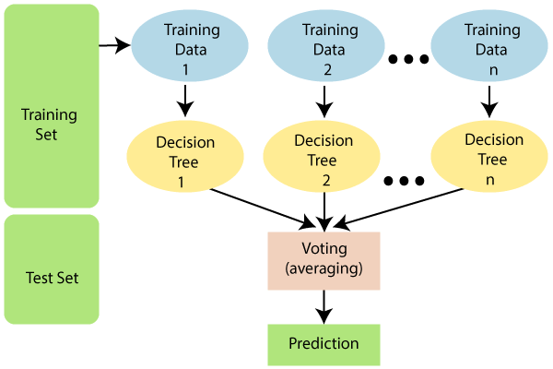
Description of the Data
- Data set is based off of a 2022 annual CDC survey of 400,000 adults related to their health status. (Kaggle)
-Data set has 39 features (patient bio markers)
-Data set shape = 246,022 rows and 40 columns (39 features and 1 target variable)
-Machine learning used is a Random Forest Classifier and Grid Search CV

Slide 4
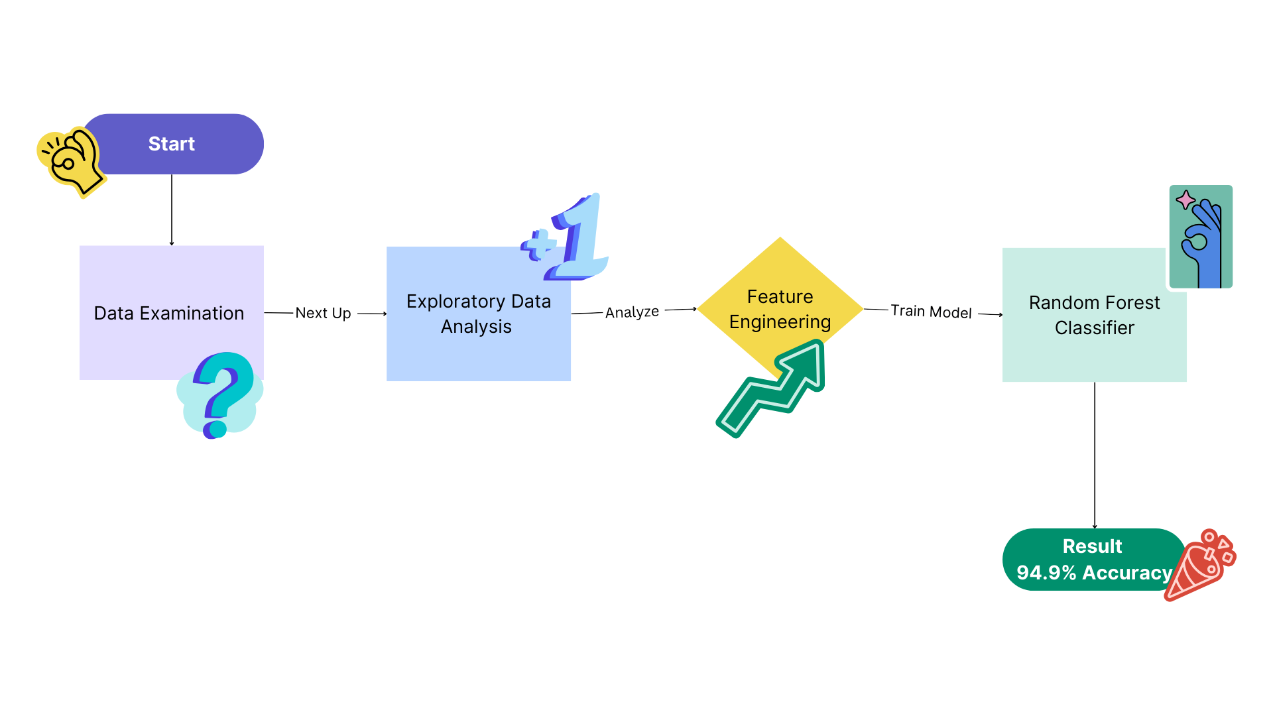
Modelling Approach
Notes:
First I imported, examined and cleaned the heart patient data from Kaggle, I then performed some analysis to help me reveal some patterns about the data including outliers and other correlations between the features. Then after, using the Zscore method I found that 13% percent of the rows in the data set had outliers and dealt with that using standardization methods to limit the effects of the outliers while preserving as much data as possible. After that I built data pipelines to encode the entire data set and all its different data types and then trained the random forest classifier model. Then I went back and retuned the model to try and get an even better result.

Slide 5

Results
- Base Model Accuracy Score = 94.8%
-This means the model predicts patient heart disease correctly 94.8% percent of the time!
-After tuning the model using GridSearchCV, the final accuracy score was 94.9%.
Notes:
Annnd for the results amazingly this model pulled off almost 95 percent accuracy! This would mean that the model is able to tell if you have heart disease or not 95 percent of the time!
And then I also saw a small improvement after fine tuning the model, which was just great .

Slide 6

Conclusion
-Step in the right direction for better healthcare insights
-It is able to predict to a high level of accuracy
-Some limitations could be
Dynamic nature of heart disease risk factors
Overfitting and generalization of data
Data availability for future use cases/dependency on clinical inputs
https://github.com/bilaal1007/Final-Project-LHL
Notes:
In conclusion this is a step in the right direction for better healthcare insghts that we can benefit from.
One of the best parts is the high accuracy of the model
However some limitations may be that patient health is always changing and will require constant upkeep and maintenance of the data
Also over fitting and generalization may make new data that comes in not predicted as accurately
And of course lack of data availability because of its dependency on clinical inputs may also be a limitation.
If you guys have more questions about this project , my contact information is on my github which Is linked on the screen

Slide 7

Thank you for listening!

